Slide 1
Seattle Neighborhoods Actively Prepare
Presented by Seattle Office of Emergency Management

Slide 2
Meeting Goals
Meet new neighbors, share contact information, and establish a meeting place
Learn what to do to be better prepared
Learn how to stay safe in an earthquake
Learn how to use Help/OK sign
Know your top three response priorities after any disaster

Slide 3
Important Links
www.Seattle.gov/emergency OEM@Seattle.gov Carl.Leon@Seattle.gov https://hazardready.org/seattle/en www.broadviewprepares.org/handouts

Slide 4




Life Safety Essentials
1. Water
2. Food
3. Staying warm & dry
4. Safe Light Source

Slide 5
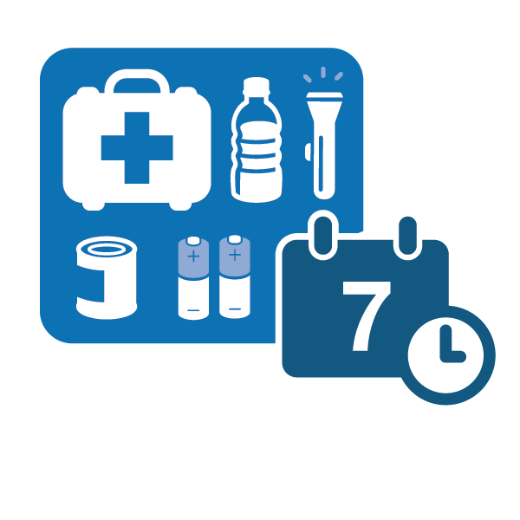
Custom Items
Medication/Health
Information - current news, copies of personal info
Unique to you - accommodate for your unique situation
Comforts - items that restore balance - words, pictures, treasured items, games, books
Connections - family, friends, neighborhood organization

Slide 6


Make a Plan
Make sure everyone is familiar with multiple evacuation routes from your home
Determine a meeting place for if you need to evacuate your home
Think about who will take care of your children and/or pets if you are unable to get home
Know emergency plans at school, work and in your neighborhood

Slide 7

Communications Plan
Decide where and how to meet
Make an emergency contact list
Consider an out-of-area contact
Use texting and social media

Slide 8




Stay Informed
Get AlertSeattle messages Sign-up online at alert.seattle.gov
Tune into local emergency radio stations AM 710, AM 1000, FM 97.3 and FM 90.7
Tune into local television
Follow City departments on social media (Twitter, Facebook, NextDoor) @CityofSeattle @AlertSeattle @OEMSeattle
Go to your nearest emergency hub Visit the Neighborhlink Map on www.seattleemergencyhubs.org

Slide 9

Sign up for emergency alerts
You can choose to receive Emergency Alerts or Community Notifications, such as:
Severe weather
Safety
Health
Special events
Utility disruptions
Major traffic disruptions
Emergency preparedness
Test messages
When emergencies happen, be the first to know. Stay informed with AlertSeattle to receive real-time, official notifications from the City of Seattle. This is a free service.
alert.seattle.gov

Slide 10
When the ground shakes…

Slide 11
After the Earthquake
Check yourself and family
Check your home for damage
Place Help/OK sign in the window
Dress for safety
Go to neighborhood meeting place

Slide 12
Top 3 Neighborhood Response Priorities
Control utilities and prevent fire
Check on people (Search and Rescue)
Take care of injuries (First Aid)
After that:
Shelter and care (take care of each other)
Damage assessment (homes, streets, utilities)
Communications (listen to radio for current information; share with family and neighbors)
Connect with other neighborhoods and/or Community Emergency Hubs

Slide 13

Organizing for success in advance
Identify a SNAP Coordinator(s) and SNAP Contact(s)
Determine roles and responsibilities
Utility control team
Search and rescue team
First aid team
Determine a meeting place

Slide 14

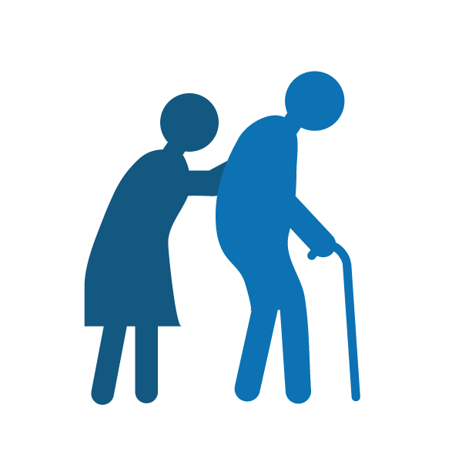

Head Start
Customize to your strengths and needs:
Who has children, pets, or lives alone?
Who has special needs?
Who has special skills?
Who works from home?

Slide 15
Make a Map
Idea: Create a map of your neighborhood - Mark your meeting place, who lives where, homes with natural gas and the meter locations.
Meeting Place
Gas Meters
First Aid Station

Slide 16
Final Review: Putting it all together
Before the earthquake:
Quake safe actions
Personal and family preparedness
After the earthquake:
Check on yourself, family, and home
Post Help/OK sign, go to meeting place
Organizing with others:
First, focus on top response priorities
Control utilities/prevent fire, search & rescue, first aid
Then, designate other teams/tasks:
Shelter & care, damage assessment, communications, hubs

Slide 17
If a disaster happens tomorrow…
Where are your earthquake safe spots at home?
Where is your neighborhood meeting place?
Follow-up items:
Do you have neighbors that aren’t here tonight?
Who will take materials to them and tell them about the meeting place?

Slide 18
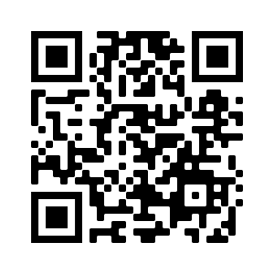
Give us feedback!
https://www.surveymonkey.com/r/oemprepare

