Slide 1
Emergency Preparedness
Presented by the Seattle Office of Emergency Management

Slide 2
Important Links
www.Seattle.gov/emergency-management
OEM@Seattle.gov
Carl.Leon@Seattle.gov
www.SeattleEmergencyHubs.org
Unofficial:
Youtube.com/@SeattlePrepares
www.n7kuw.com/Handouts/
(hint: download handoutlist.pdf first)

Slide 3
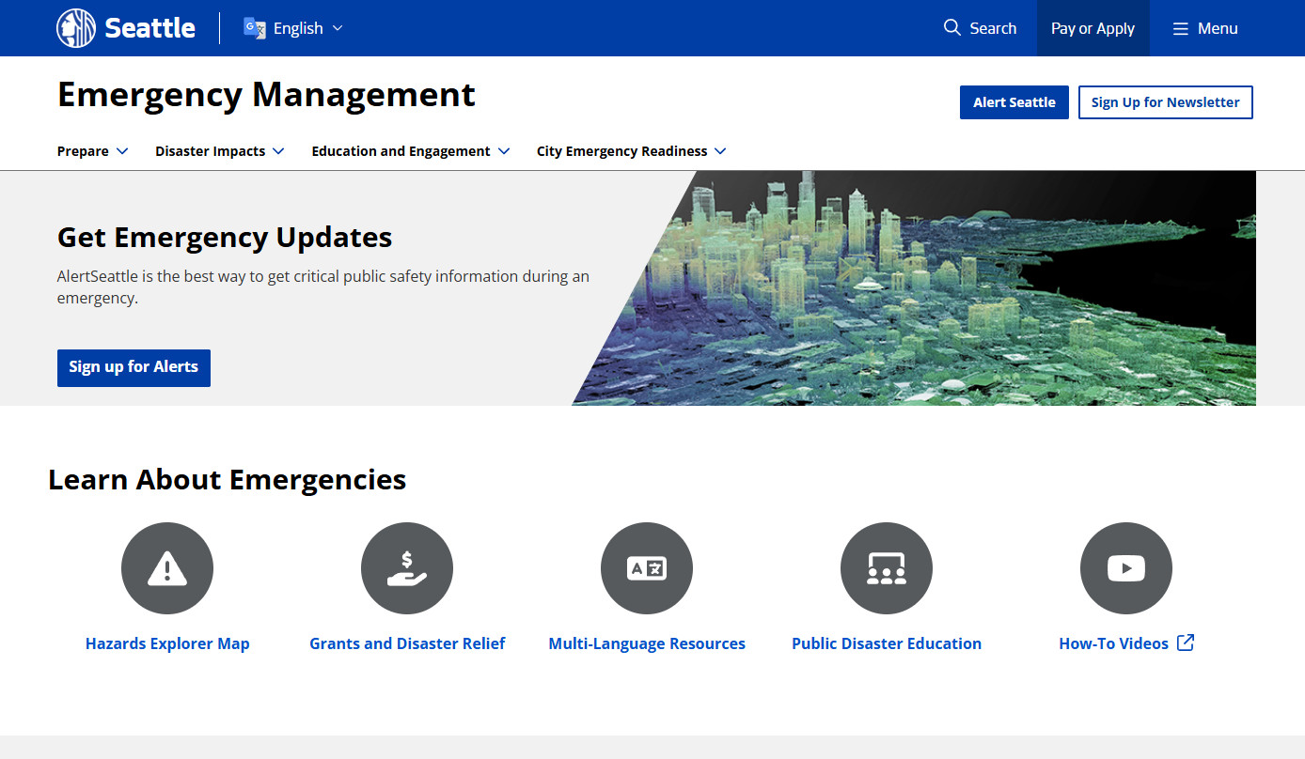
Seattle.gov/emergency-management

Slide 4
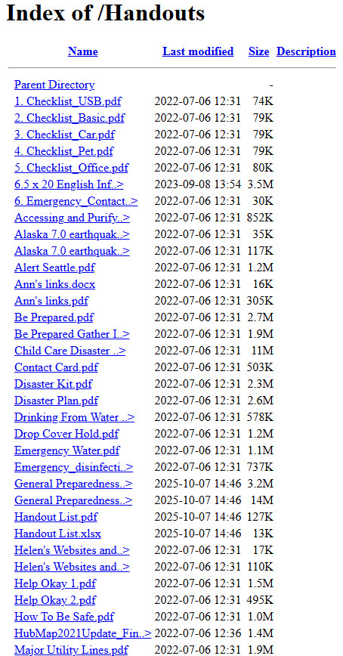
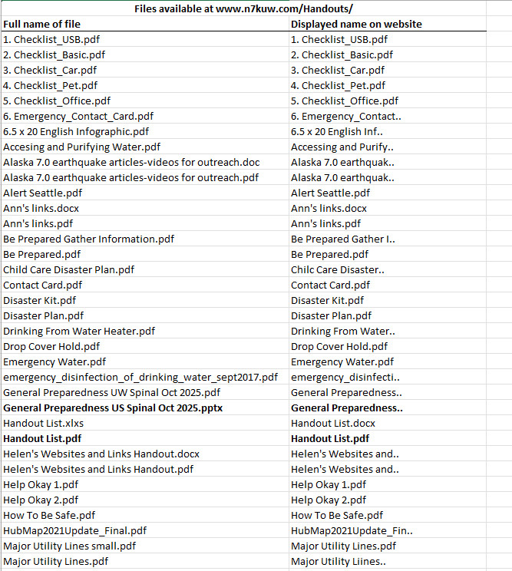
www.n7kuw.com/Handouts

Slide 5
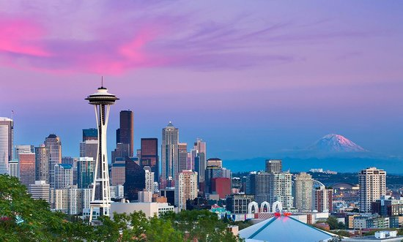
Seattle is vulnerable to many disasters…

Slide 6
Seattle’s top hazards…
Earthquakes
Snow and Ice
Windstorms
Power Outages
Cyber Attacks
Landslides
Disease Outbreaks
Flooding
Excessive Heat
10. Tsunamis/Seiches
11. Infrastructure and Structural Failures
12. Fires
13. Transportation Incidents
14. Water Shortages
15. Social Unrest
16. Attacks
17. Hazmat Incidents
18. Volcanic Hazards
Notes:
The Office of Emergency Management compiles a document known as the Seattle Hazard Identification and Vulnerability Analysis.. Long name so we lovingly refer to it as the SHIVA (also the name of the Hindu god known for destruction!)
Document looks at all the things that could happen and their impacts, and ranks them based on how extensive the impacts could be and the frequency with which the type of event happens. It also considers “Cascading Impacts”. Earthquakes for example, damage, injuries etc. caused by shaking, but the cascading impacts are even worse, disrupted transportation, utilities, communication, etc.
Considering all of these things, Earthquakes are the number one hazard.
Snow and Ice and Windstorms have similar impacts to earthquakes in terms of disruption to transportation, utilities etc. But the scope is usually small enough that impacts can be deal with in a matter od hours or days, as opposed to weeks, months, or years.
I usually reference the New Yorker Article here: (How many people read or heard about the New Yorker article about the potential giant earthquake?)
The person who wrote the New Yorker article (Kathryn Schultz) actually won a Pulitzer for the story. Most people don’t know however that she wrote a second story a week after the first titled “How to stay safe when the big one comes”. The second story focused on what you can do to prepare. Anecdotally (and have joking) based on my conversations, I think about 100 million people read the first article that focused on this terrible thing that is going to happen, and about 4 people read the second article that basically said, “hey its not that bad you can do something about it!”
http://www.newyorker.com/tech/elements/how-to-stay-safe-when-the-big-one-comes
The new Yorker article focused on one type of Earthquake (Cascadia subduction zone), we also have several other types.

Slide 7
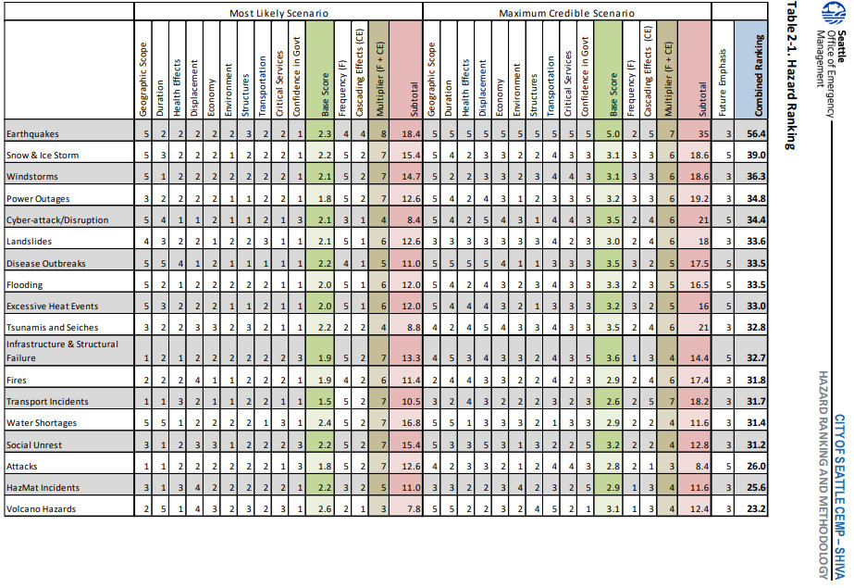
SHIVA – Seattle Hazard Index and Vulnerability Analysis

Slide 8
Earthquakes in Seattle
The Seattle area experiences three earthquake types with three very different consequences.
1. Crustal or Shallow Quakes
Seattle Fault, ~1100 years ago (~7), N. Bend April 1945 (5.7)
2. Intraplate or Deep Quakes
Nisqually 2001 (6.8), April 1965 (6.5), April 1949 (7.1), February 1946 (5.8)
Average ~ 20 years, minimum 3 years, maximum 56 years
3. Subduction Zone or Megathrust Quakes
Cascadia, January 1700 (~9) (average every 500 years)
Notes:
The New Yorker article focused on one type of Earthquake (Cascadia subduction zone), we also have several other types.
Crustal or Shallow Quakes: These quakes happen very close to the surface and thus produce more violent shaking. These pose the biggest threat to Seattle. The Seattle fault runs through the Puget Sound, from around Bainbridge island, straight through downtown Seattle. Because the quake would happen closer to the surface and is right beneath our most populated areas, it would be the most damaging. These happen less frequently that our other types of quakes, with the last one occurring 1100 years ago.
Deep Quakes: These are the most common quakes in the region and happen on average about every 50 years. Ex. Nisqually 2001. They are called “Deep” because they originate 30-70 km below the surface, so by the time the shaking reaches us, it is typically not as strong as other types of quakes.
86% chance of a 6.8 or greater earthquake in next 50 years
Subduction Zone: Fault runs from Vancouver island down the coast to N. California. Potential for 8.0 -9.0 and greater quakes. Typically these have happened on average every 250-500 years. (only an average though, sometimes there have been 1,000 years between quakes, sometimes 100).
Chance of an 8.0 or greater quake in next 50 years = 33%
Chance of a 9.0 or greater in next 50 years= 15%

Slide 9
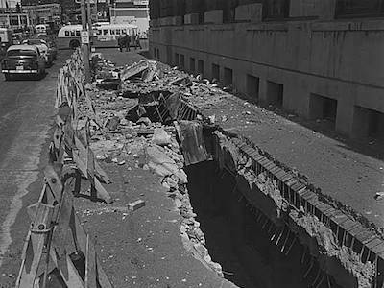
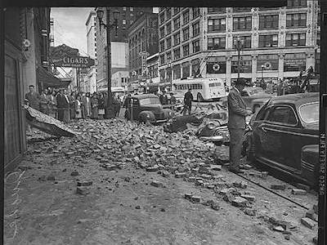
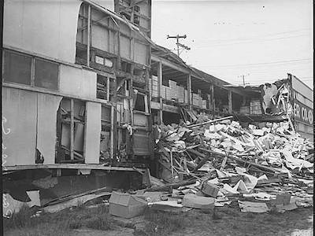
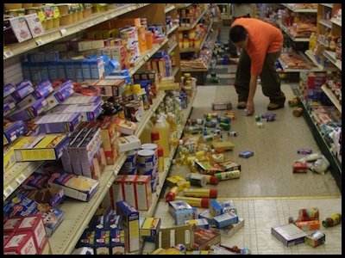
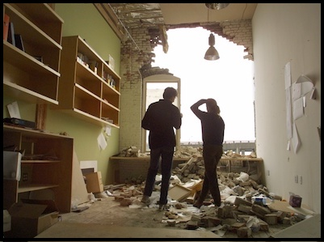
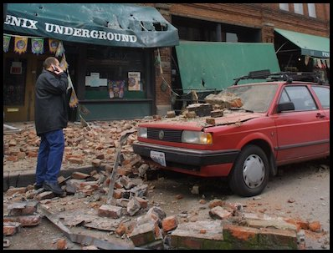
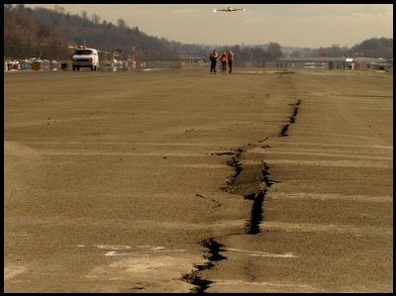
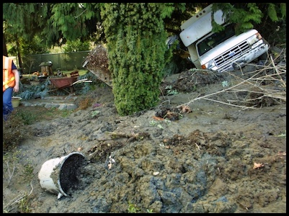
Earthquakes in Seattle
1949 Seattle Fault Quake & 2001 Nisqually Quake

Slide 10
Seattle Hazard Explorer & King County Ready Tool
Seattle.gov/emergency-management
Scroll down to Seattle Hazard Explorer
www.hazardready.org/seattle
Lets you explore specifics of each type of hazard, and shows where the vulnerable areas are within the City.
What are your risks
  What to expect
  How to prepare
  In Recent History
Notes:
After the New Yorker article OEM did a series of presentations in libraries on earthquake risk and preparedness. We brought a long big paper copies of hazard maps that showed areas of the city prone to landslides, flooding, liquefaction and other hazards. People gravitated toward these and wanted to see where their house is, where their workplace is etc.
From that experience we built the Seattle Hazard Explorer. These online maps take all of the data from our SHIVA and put it into an interactive accessible format, where people can explore this data and see how it overlays with places important to them. Are you in a flood prone area, or a landslide prone area, or liquefaction? In an area that might experience more shaking during an earthquake? In a potential tsunami inundation area?
Won’t go into detail now, but check out the Hazard Explorer!
OEM developed the HazardReady tool with some researchers from the University of Montana. This toll provides King County wide data and a more text-based result. Type in an address in King County, and get a customized report of what risks you face.

Slide 11
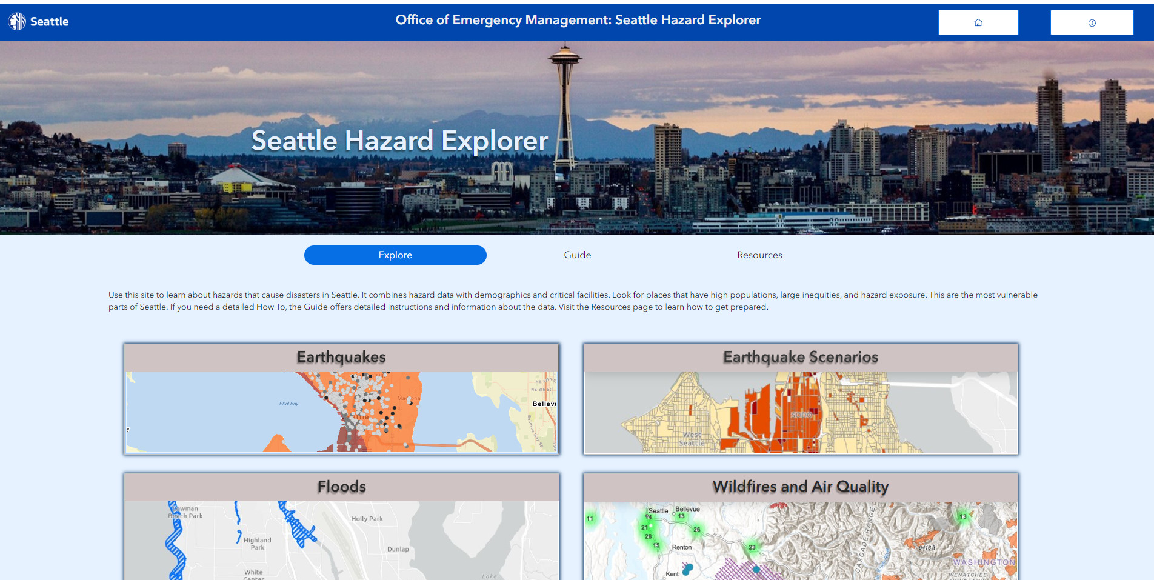

Slide 12
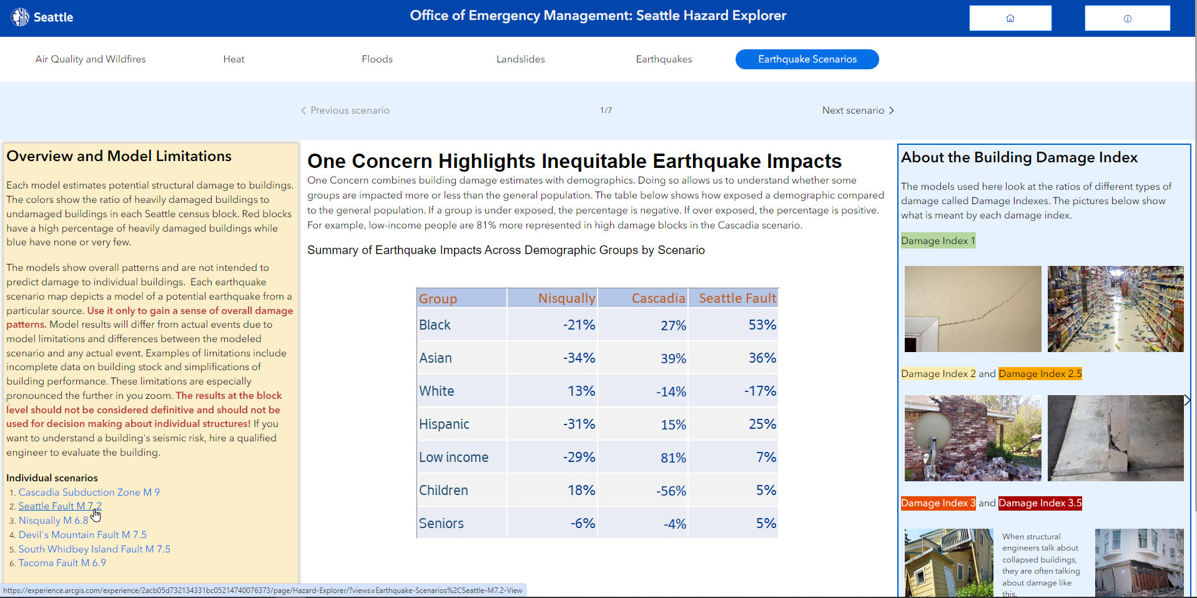

Slide 13
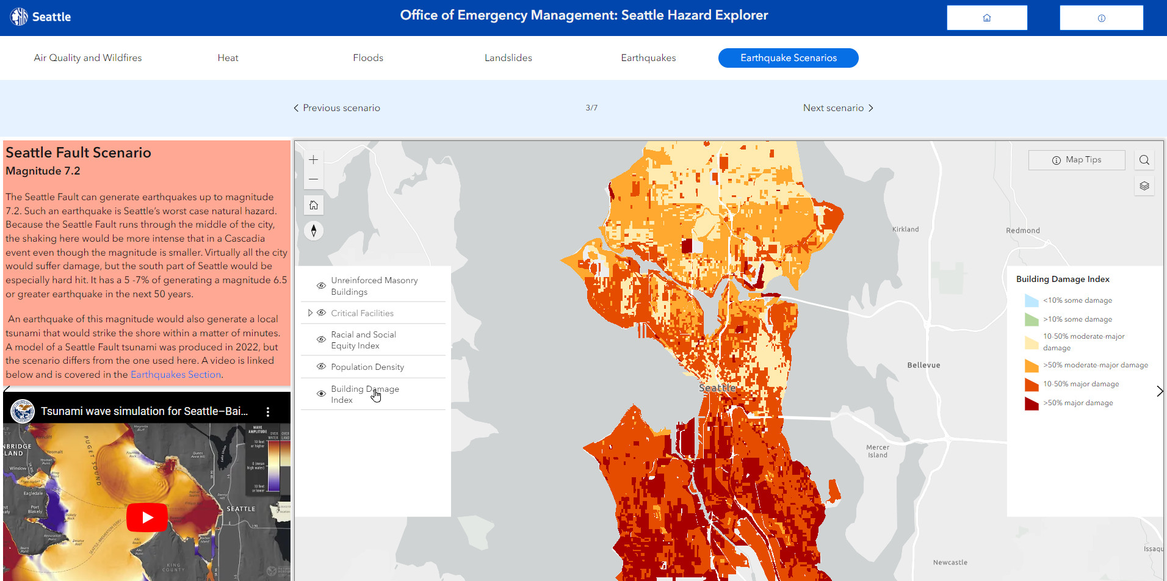

Slide 14
Know the reality
Events happen all the time; most do not impact the majority of people, cause significant damage, or have huge economic impact. But they CAN disrupt YOUR life, YOUR daily activity.
Medium events happen regularly, but mostly only still impact a minority of people, not everyone (think a major traffic incident that closes a freeway or bridge for an extended period).
Major events happen infrequently, can impact a much larger percentage of people, but are still managed at the local or regional level (think the recent “Bomb Cyclone” or some winter storms)
Notes:
Everything we will talk about in terms of preparedness comes from this reality! You may not have the things you normally have, so do what you can now to prepare for that reality!
Stores running out of supplies: Who saw pictures of or experienced empty shelves during the February 2019 snow event? If a few inches of snow empties the shelves, imagine the situation after a major earthquake (assuming stores can even open)
First responders overwhelmed: For context, explain how Seattle Fire works post earthquake. Each station has a designated route in their neighborhood, with lists of important locations to check (nursing homes, schools, other high occupancy buildings, unreinforced masonry buildings). There first job is just to drive an assess. The intention is that they do not stop. They need to determine which things are the highest priority, so they can devote their limited resources to those incidents. E.g. if there is a collapsed school, they will focus on the before a single family house fire. Fire stations will break into battalions, and each battalion will essentially act as its own fire department.

Slide 15
Know the reality
Catastrophic Disasters such as major Earthquakes happen very infrequently, but impact a large majority or all of the population and require national or international response for recovery.
Notes:
Everything we will talk about in terms of preparedness comes from this reality! You may not have the things you normally have, so do what you can now to prepare for that reality!
Stores running out of supplies: Who saw pictures of or experienced empty shelves during the February 2019 snow event? If a few inches of snow empties the shelves, imagine the situation after a major earthquake (assuming stores can even open)
First responders overwhelmed: For context, explain how Seattle Fire works post earthquake. Each station has a designated route in their neighborhood, with lists of important locations to check (nursing homes, schools, other high occupancy buildings, unreinforced masonry buildings). There first job is just to drive an assess. The intention is that they do not stop. They need to determine which things are the highest priority, so they can devote their limited resources to those incidents. E.g. if there is a collapsed school, they will focus on the before a single family house fire. Fire stations will break into battalions, and each battalion will essentially act as its own fire department.

Slide 16
In a catastrophic disaster, the services you rely on will be significantly disrupted. In lesser magnitude of disaster, the impacts will be less, perhaps not at all.
People may not be able to get places easily (roads, bridges damaged, transit will stop)
Stores may quickly run out of supplies
Utilities may be damaged (electricity, water, sewer)
Gas stations and ATM machines may not work – cash only society
Hospitals may be overwhelmed
Phones, cable TV, and internet may not work
First responders may not be able to help you for some time
Notes:
Everything we will talk about in terms of preparedness comes from this reality! You may not have the things you normally have, so do what you can now to prepare for that reality!
Stores running out of supplies: Who saw pictures of or experienced empty shelves during the February 2019 snow event? If a few inches of snow empties the shelves, imagine the situation after a major earthquake (assuming stores can even open)
First responders overwhelmed: For context, explain how Seattle Fire works post earthquake. Each station has a designated route in their neighborhood, with lists of important locations to check (nursing homes, schools, other high occupancy buildings, unreinforced masonry buildings). There first job is just to drive an assess. The intention is that they do not stop. They need to determine which things are the highest priority, so they can devote their limited resources to those incidents. E.g. if there is a collapsed school, they will focus on the before a single family house fire. Fire stations will break into battalions, and each battalion will essentially act as its own fire department.

Slide 17
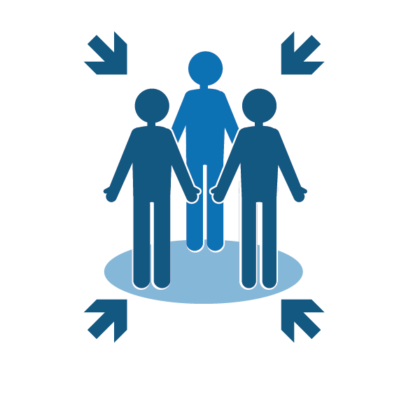

Develop a plan
Consider the following:
How will you reunite with family?
Know alternate routes home and to work
Know plans for work and children’s schools or day care
What if you have no electricity?
What if you have no water service?
What if you can’t occupy your home?
What about your pets?
Notes:
For me the most important part of a “plan” is being in the mindset that the reality we just discussed, could in fact be a reality. Think about what you might do in these situations and put in place what you can before hand.
Refer people to the Infographic insert (Hopefully you provided this) . This can help them record a lot of the things we will discuss
http://www.seattle.gov/Documents/Departments/Emergency/Be%20Prepared%20Infographic/OEM%20Be%20Prepared%20Insert(0).pdf
If you are separated from family, how will you reunite. Consider that you may not be able to get to the same location, so consider how you will communicate which we will discuss in a moment.
Know plans for your work and children’s school. OEM does training with Seattle Public Schools on family reunification, training teachers on the process that the school district will use to account for students and reunite them with parents. Ask the school about those plans so that expectations are clear. Similarly, learn about plans in your workplace.
Transportation may be disrupted: Know alternate routes. These days we often rely on our phones for navigation if we need to take an unfamiliar route. Know these routes beforehand, document them, have a map, know available public transpiration routes.
(Matt) here I often insert a story to get across the point that you need to know alternate routes and that you might actually have to walk (! Shocker I know).
In 2001 I had just moved to NYC to start college, and on Sept. 11 2001 I had been there for about two or three weeks. I lived in Brooklyn and commuted via the subway to my school everyday which was in Manhattan at 10th Ave and 59th St. That day I was at my stop in Manhattan when they emptied all the trains and made people get off. I walked to school and then we quickly realized what was happening. Subways weren’t running, cabs weren’t running. I saw someone I knew, and we walked. home It was about 7 miles and took quite a long time. But that was the best option we had. You are likely going to have to improvise, and you will be inconvenienced!
*Technology Tip: Many mapping apps exist that allow you to download maps to your phone so that you have navigation capability even if you have no cell service or wifi. I use Maps.me. This app will download maps for an area including locations such as restaurants, stores, hospitals etc. and will give you tun by turn directions even with no service.

Slide 18
Questions I was asked to address with regard to disability related concerns:
People with spinal cord injuries or similar disabilities
Include the disabilities in whatever individual/specific plans you make
Mobility issues, wheelchairs (power or regular)
As above. If power take charging into consideration
Medications
Stock up – 2 weeks to 90 days on hand, carry a week with me
Ventilators/need for generator, etc.
Generator, spare batteries, solar – all have to be planned in advance
Communications with emergency personnel ahead of time
Plan ahead, communicate ahead, reach out to whomever in advance
How to get people off Mercer Island if bridges are not available
    Seattle would not be responding agency/entity. I’m not aware of any specific plans for any island community. There may well be plans, but you need to reach out to your local emergency management/fire/police.

Slide 19

Communications Plan
Include the following in your communications plan:
Texting is your best option
Establish text message groups
Social media
Don’t make calls unless absolutely necessary
Preserve phone battery
Notes:
In terms of planning, one of the most important things is communication
Texting is more likely to go through after an emergency when lines are overwhelmed
You can establish text groups before an emergency, that way with the push of a button you can send a message letting everyone know you are ok
Social media
Common platforms like Facebook have built in functions. Facebook Safety Check often activates after a major event and will give people in the affected the area the option of letting friends know they are safe. https://www.facebook.com/about/safetycheck/
Some apps exist that will allow you to send text messages over short distances even without wi-fi or data. Fire Chat: https://www.opengarden.com/firechat.html
One of the most important things is to NOT make unnecessary calls. We need lines to remain open for true emergency calls.

Slide 20
Insurance and Government Assistance
Do not rely on FEMA or other government assistance as your insurance plan
  Usually no more than $35,000 for a total loss
  Small Business Administration (SBA) Loans vs. Individual Assistance Program (IAP)
Homeowner’s Insurance vs. Renter’s Insurance
Know what your insurance covers and what it does not
  Earthquake – must be purchased separately
  Flood – must be purchased separately through the NFIP
    Rising water vs. Falling water
Notes:
It is extremely important to understand that government assistance should not be your plan.
Even in a presidentially declared disaster, where Seattle is eligible for all possible FEMA assistance, the assistance available to individuals is very limited.
The median home value in Seattle is $718,500. The maximum FEMA individual assistance pay out is $34,900. If you have no earthquake insurance, and your home is a total loss, what would that mean for you??

Slide 21
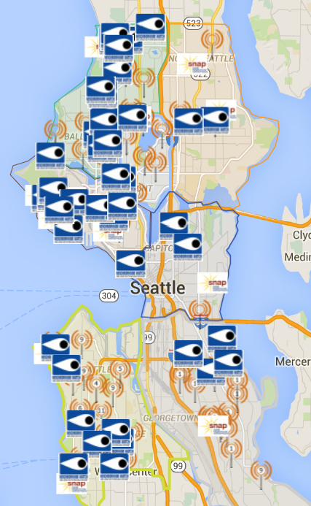


Know your neighborhood’s plan
Help each other
Community Emergency Hubs
seattleemergencyhubs.org
SNAP Groups
Seattle.gov/emergency/snap
Notes:
Know your neighborhoods plan
Our ability to work with those around us is going to be crucial after a major disaster,. Get to know your neighbors now!
Is there a Community Emergency Hub near you? Check the Neighborlink map to find out
Are you part of an existing SNAP group in your neighborhood? Is there an existing group you good join? (Again check the neighborlink map). If you are a part of a group, where is the meeting place? What role might you play?
If you are interested in organizing your neighborhood, you can request a training from OEM or you can access the SNAP materials at our website and get started on your own. Seattle.gov/snap

Slide 22
Notes:
Know your neighborhoods plan
Our ability to work with those around us is going to be crucial after a major disaster,. Get to know your neighbors now!
Is there a Community Emergency Hub near you? Check the Neighborlink map to find out
Are you part of an existing SNAP group in your neighborhood? Is there an existing group you good join? (Again check the neighborlink map). If you are a part of a group, where is the meeting place? What role might you play?
If you are interested in organizing your neighborhood, you can request a training from OEM or you can access the SNAP materials at our website and get started on your own. Seattle.gov/snap

Slide 23
Top 3 Neighborhood Response Priorities
Control utilities and prevent fire
Check on people (Search and Rescue)
Take care of injuries (First Aid)
After that:
Shelter and care (take care of each other)
Damage assessment (homes, streets, utilities)
Communications (listen to radio for current information; share with family and neighbors)
Connect with other neighborhoods and/or Community Emergency Hubs

Slide 24

Organizing for success in advance
Identify a SNAP Coordinator(s) and SNAP Contact(s)
Determine roles and responsibilities
Utility control team
Search and rescue team
First aid team
Determine a meeting place

Slide 25

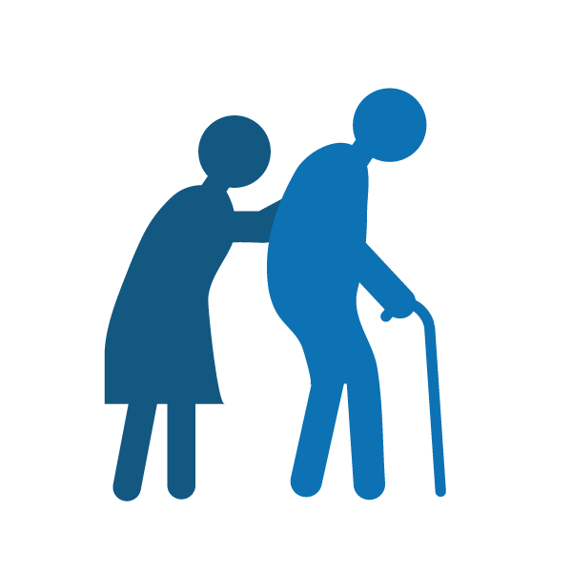

Head Start
Customize to your strengths and needs:
Who has children, pets, or lives alone?
Who has special needs?
Who has special skills?
Who works from home?

Slide 26
Make a Map
Idea: Create a map of your neighborhood - Mark your meeting place, who lives where, homes with natural gas and the meter locations.
Meeting Place
Gas Meters
First Aid Station

Slide 27
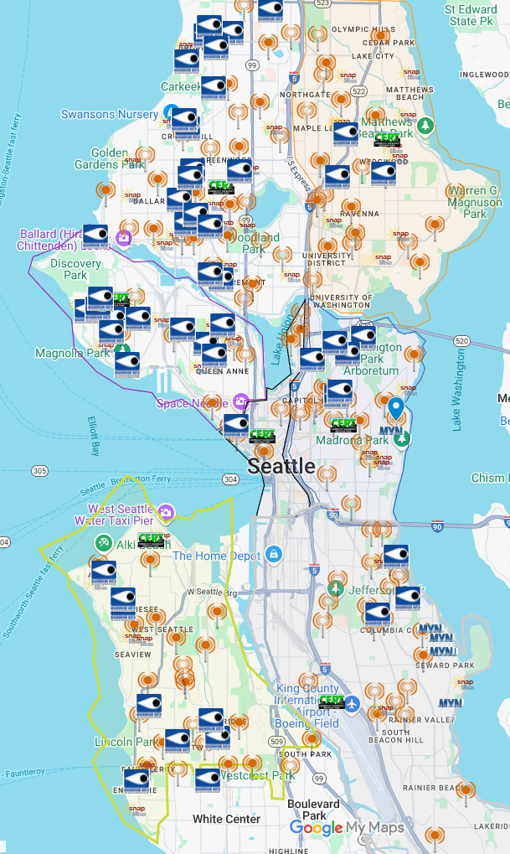
HUBS
SeattleEmergencyHubs.org
Notes:
Know your neighborhoods plan
Our ability to work with those around us is going to be crucial after a major disaster,. Get to know your neighbors now!
Is there a Community Emergency Hub near you? Check the Neighborlink map to find out
Are you part of an existing SNAP group in your neighborhood? Is there an existing group you good join? (Again check the neighborlink map). If you are a part of a group, where is the meeting place? What role might you play?
If you are interested in organizing your neighborhood, you can request a training from OEM or you can access the SNAP materials at our website and get started on your own. Seattle.gov/snap

Slide 28
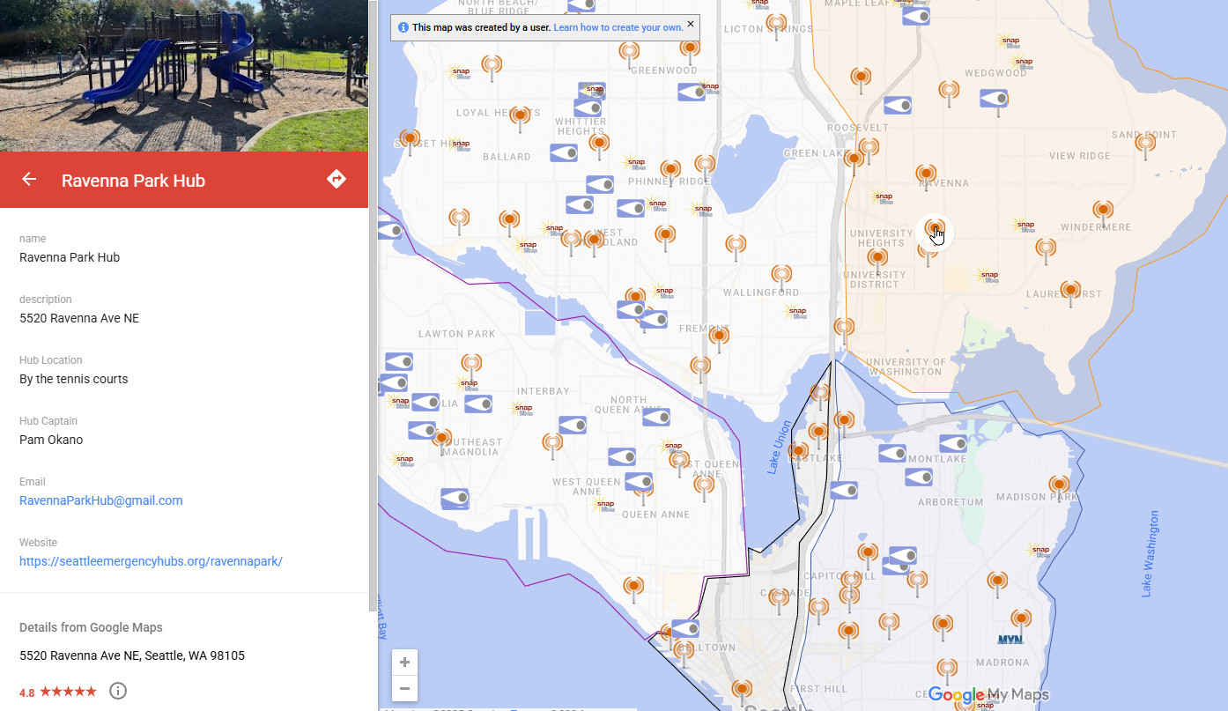
Notes:
Know your neighborhoods plan
Our ability to work with those around us is going to be crucial after a major disaster,. Get to know your neighbors now!
Is there a Community Emergency Hub near you? Check the Neighborlink map to find out
Are you part of an existing SNAP group in your neighborhood? Is there an existing group you good join? (Again check the neighborlink map). If you are a part of a group, where is the meeting place? What role might you play?
If you are interested in organizing your neighborhood, you can request a training from OEM or you can access the SNAP materials at our website and get started on your own. Seattle.gov/snap

Slide 29
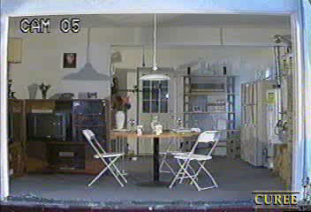
Home Hazard Mitigation and Retrofitting
Secure the following:
Large furniture
Wall hangings
Kitchen cabinets & contents
Water heater
Washer/Dryer
Stoves
Hazardous Materials
Go on a 30 minute home hazard hunt.
Attend a free home retrofit class.
Visit seattle.gov/emergency to register on our events calendar.
Retrofit your home
See a list of contractors on OEM’s website.
Notes:
Doing some non-structural mitigation in your home is a great way to decrease the risk of injury and utility disruptions.
Most injuries during an earthquake are due to falling objects:
Secure large pieces of furniture to walls
Don’t hang heavy objects over beds
Lowes/Home Depot in the area generally have a display with relevant earthquake straps
Make sure you connect any straps or brackets to studs in the wall
Take 30 minutes and walk around your home, think about what things could be dangerous during an earthquake.
(Matt) I usually tell a story about a story Q13 wanted to do after the New Yorker article. We did a walk around in one of the producers homes, pointing out things that might be secured to walls. As we walked in the bedroom I noticed a glass chandelier hanging over the head of the bed….. The woman just put her head down in shame and told the camera man not to film it. Perhaps an obvious one, but it goes to show that we are not always thinking in the context of an earthquake. Its good to do a walk around with the earthquake in mind.
Many gas leaks following earthquakes can be caused by gas appliances tipping over and ripping gas lines from the wall.
http://www.seismic.ca.gov/pub/CSSC_2002-03_Natural%20Gas%20Safety.pdf
“As demonstrated by recent earthquake experience, shifting or toppling of gas appliances such as water heaters, boilers, furnaces, dryers and stoves is the principal cause of most gas-related, post-earthquake fire ignitions (71% in the Northridge earthquake).”
Another factor that could increase risk of utility disruptions: Living in a home that has not been seismically retrofitted
Typically homes built before 1980 were not secured to the foundation. Essentially it is only gravity that is keeping the home on the foundation.
Having an unretroffited house can also increase the risk of utility damage.
OEM regularly teaches home retrofit classes: A trained contractor instructs participants on assessing whether their home has been retrofitted, the elements of a seismic retrofit, processes for getting permits and plans etc.

Slide 30
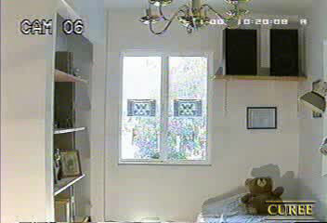

Slide 31
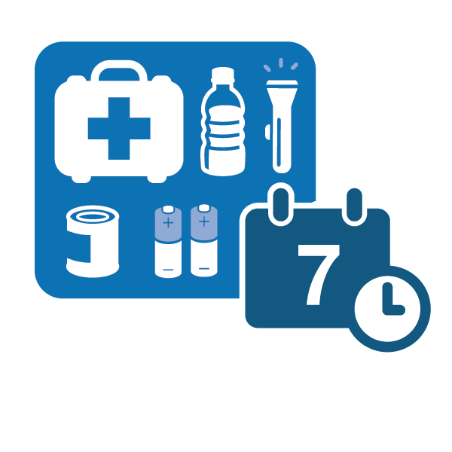
Build a Kit
Be prepared to be on your own for 14 days.
Think about what you use on a daily basis, and include those items in your kit: Food, water, stay warm & dry, safe light source, medication/health
Have a kit in your car and at work (get home bag)
Notes:
When we talk about supplies to have on hand, we do this with the understanding that stores may not be open or running out of supplies and getting places may be difficult with transportation down.
The infographic you have list a lot of items that are good to have. I won’t go in to detail on all of those. But it is good to keep in mind that you may already have a lot of these things, and it may just be a matter of gathering them together to do a quick inventory. But there are definitely some thinks that are key.
Food and water, especially water! You can go quite a long time without food, but this is not so without water. We recommend one gallon per person per day. (for up to 7-10 days). This can sound like a lot, but you may have some sources of water in your home already. A typical water heater holds 30-60 gallons of water. We will talk about accessing water a little later.
Keeping your phone charged. (Matt) when working in NY after Hurricane Sandy, we saw a lot of people coming to shelters because they had no home to live in anymore. But we saw even more people coming to charge their phones. Cell networks may be up, and phones can be useful regardless. So have some way to keep your phone charged goes a long ways. Extra battery, battery charging packs that usually give you one or two extra charges (very affordable these days), crank or solar charges, AA or AAA powered chargers.
If you take medications daily, having extra is key. Don’t let your supply get down to nothing before refilling. If you consistently refill with a few days left, then you will have extras on hand. Using an online pharmacy may also allow you to get prescriptions for longer periods of time.
Having some cash on hand is also a good idea. Power outages may result in ATMs not working or stores not being able to take cards.
Also think about having some basic supplies at work and in your car. The earthquake isn’t necessarily going to happen while you are at home. What are some simple things that you could have in your car or at home?
Don’t wait until your car is on E to fill up. Having at least a half a tank of gas could be a great resource after a disaster. Charging your phone, getting around etc. If you have gas in your car, you can make educated decisions about how to conserve and use what you have wisely.
Important Documents: Have copies in a go bag, send copies to relatives out of the area, store electronic copies in cloud.

Slide 32
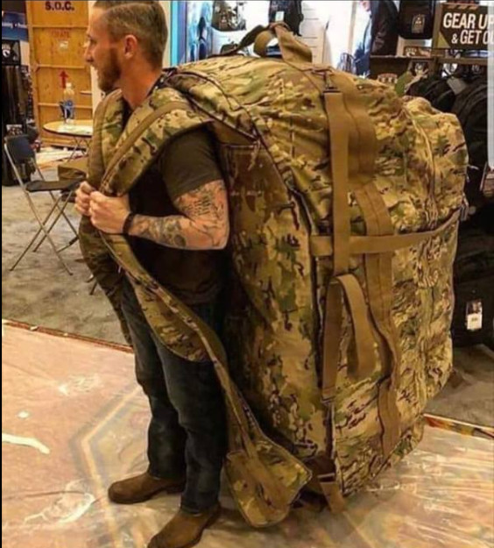
“Get Home Bag”
  Water & Food
  Sturdy shoes
  Rain poncho
  Paper Map!
  Whistle
  Mask
  Flashlight / Headlamp
  Extra batteries
  Cash
  Picture of family / pets
  Emergency phone numbers
    Loved ones
    Out-of-town contact

Slide 33
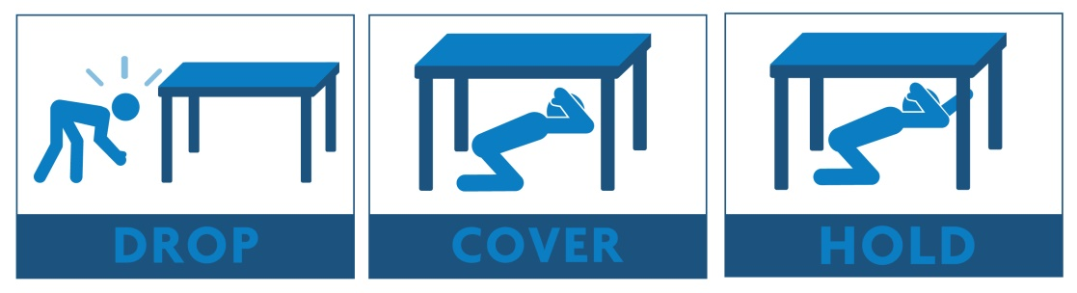
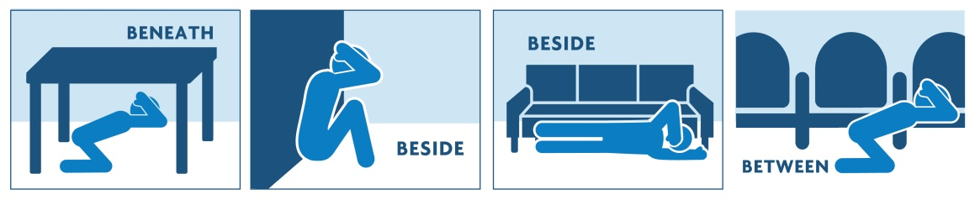
What to do during an earthquake
Don’t run during the shaking
Drop, Cover, and Hold under a desk or table
If there’s no table, find the nearest safe place beside an inside wall.
If outside in an open area, sit down and cover your head with your arms
If in the ‘danger zone’ next to a building, try to get back into the building and find shelter.
Notes:
So you have taken all of the steps to prepare before hand, what about when the earthquake happens?
The best thing you can do during an earthquake is to DROP, get onto the ground, COVER, get under something sturdy like a desk or table and cover your head, and HOLD, hold on to whatever you are underneath.
For many this is very simple messaging that they have heard over and over again. Keep in mind we have a lot of people in Seattle from other parts of the country or other parts of the world where earthquakes are not a common occurrence. People that are not familiar with earthquakes often thing they should try to get out of the building, or take some other action.
If you can’t get down on the ground, the best thing to do is get up against an interior wall, away from windows, and cover your head.
If you are in a wheel chair: Lock your wheels and cover your head

Slide 34
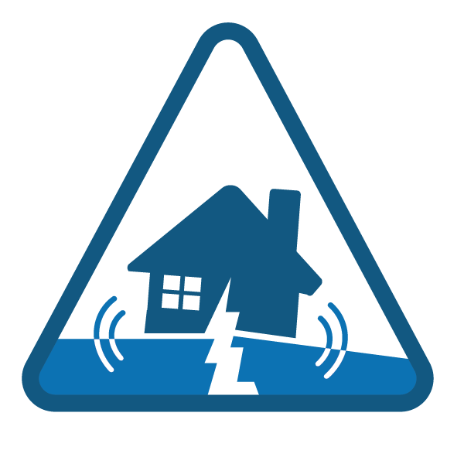
What to do after an earthquake
Check on yourself and your family for injuries
Check on your home
Check on others
Find out more information
Notes:
After the shaking stops, there are some basic steps to take:
1. First and foremost make sure that you are ok, and check on your family or others immediately around you. Having basic first aid skills is a plus.
2. Check on your home. This includes controlling utilities (I’ll talk more about this in a moment), controlling any fires, and checking for structural damage.
3. Check on others: See who in your neighborhood might need help. Do some light search and rescue to help those in need.
4. Find out more information about the situation
If you have planned with neighbors, you may have defined a place to meet so you can start working on these priorities together. If there is something you are interested in doing, go to Seattle.gov/snap to learn about how you can plan with your neighbors.

Slide 35
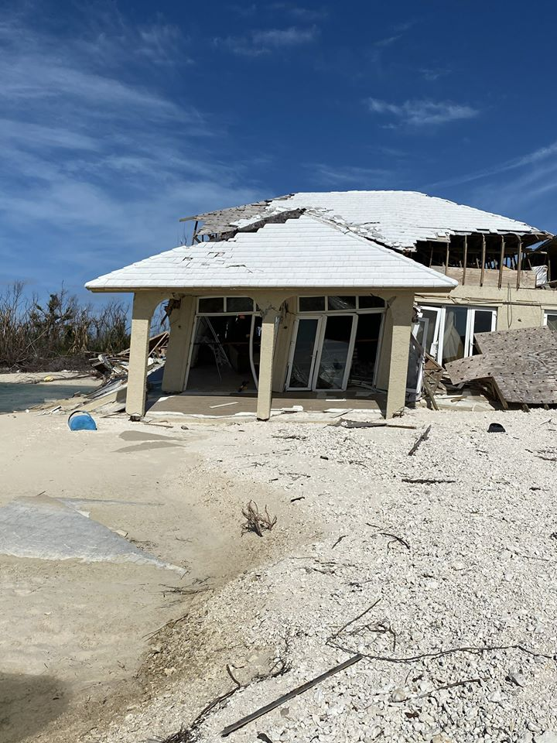
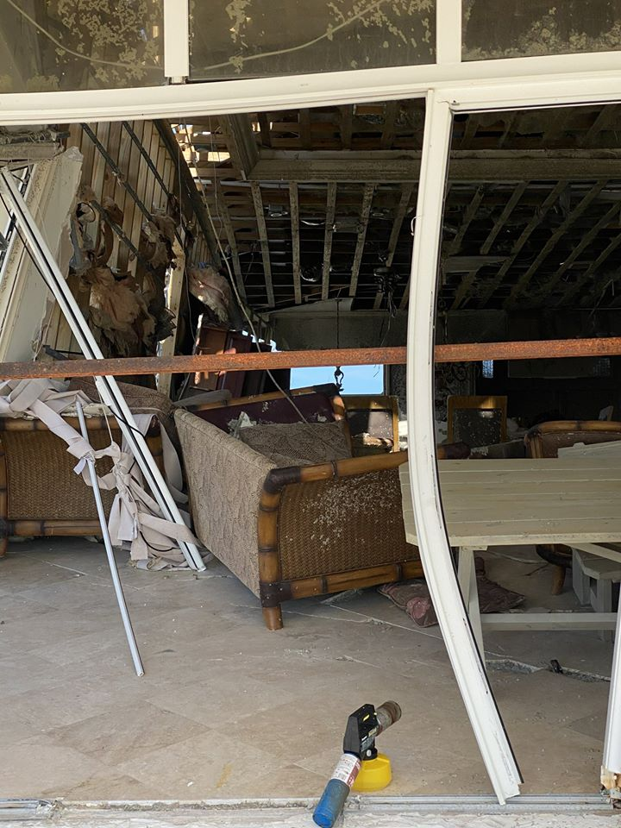
Why you Drop, Cover, and Hold!
Safe to Re-enter?

Slide 36

Emergency Sanitation
Following a major disaster, water and sewer lines may be disrupted. Do you know how to improvise an emergency toilet?
Supplies:
• 2 Plastic buckets with lids
• Heavy duty garbage bags and ties
• Absorbent material like cat litter or shredded newspaper
• Household bleach
• Soap
• Rubber gloves
• Toilet paper
• Antiseptic towelettes
• Hand sanitizer
Notes:
If water systems are disrupted, sewer systems will be disrupted as well. This can quickly became a problem. But having some basic supplies on hand will allow you to construct an emergency toilet system and minimize the impacts.
Why two buckets?
A day worth of pee has 10 times the volume of poo. Pee is generally sterile while poo contains pathogens and requires special care. By separating the two you can minimize the issues with disposal.
One bucket will do, but two is preferred.
It is important to note that if the sewer system is disrupted, restoring the system and finding temporary solutions will be a high priority for government because of the potential far reaching public health consequences. However during an event that is impacting the entire region, there will likely be a delay in bringing in outside resources.

Slide 37
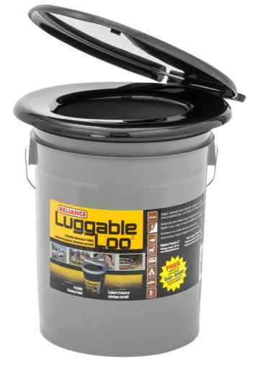
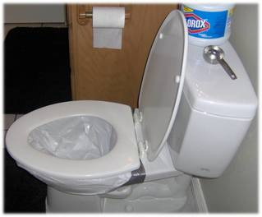
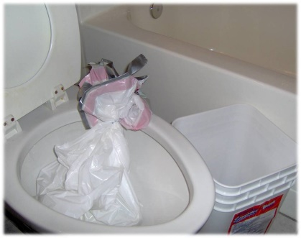
Sanitation
City Guidance:
Bag it up and store waste safely until it can be picked up.
Options:
Line your own toilet with garbage bags (13 gallon)
Emergency/camping toilet (5 gallon bucket w/lid and seat)
Have two, one for liquid waste, one for solid waste.

Slide 38
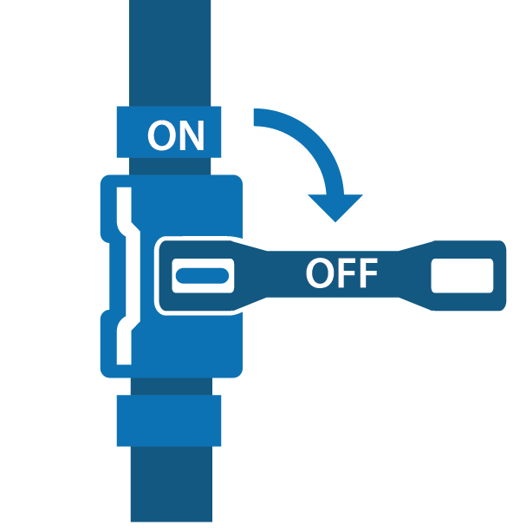
Know how and when to control utilities
Shut off natural gas ONLY if necessary
Only shut it off if you smell natural gas, hear a hissing sound, or the dial is spinning rapidly
Notes:
One of the primary aspects of checking on your home, is knowing how and when to turn off your utilities. I just want to give you some basic information today, but you can attend one of our Disaster Skills classes to get more detail.
Gas
Earthquakes can cause gas leaks and these leaks can pose life safety issues, including fires. So knowing how to turn your gas off is important.
- Only turn gas off if you have some reason to believe there is a leak. This means you smell gas leaking or hear gas leaking.
- If you shut the gas off, contact the gas company. They will need to turn it back on.
2. Water
After an earthquake, it is a good idea to shut of your water at the main valve. This ensures that you keep the water you have. If there is damage to a water main somewhere outside your home, it could cause the water in your home to drain if you do not shut it off.
- The main water valve is usually in the basement or a utility closet
- It is fine to turn the water back on yourself, so this is a good one to practice beforehand. Find your water shut off and make sure you can operate it.
You can also watch some short instructional videos on the OEM website that go over controlling utilities. On the OEM website in the “Preparedness” section, there is a “Training and Workshops” section. The skills videos can be found under “Online Courses”.

Slide 39
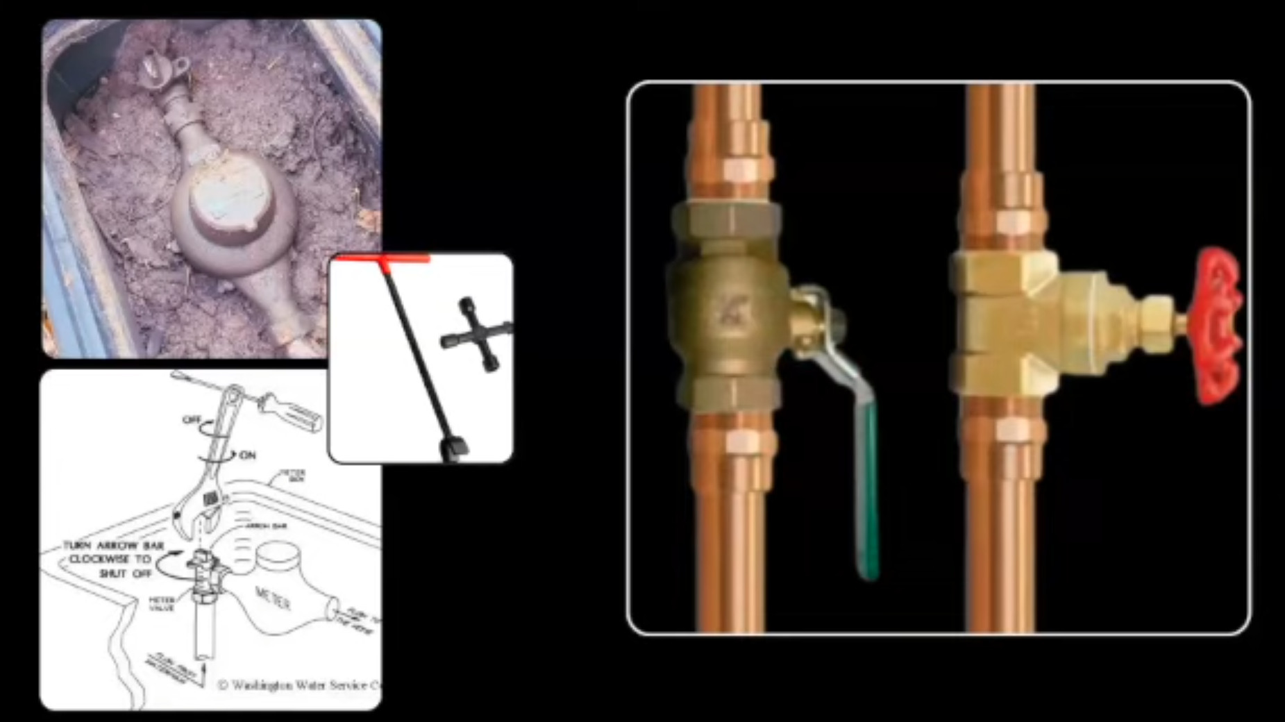
Shut off water at the main house valve
Typically located right outside your house or inside
This saves the water in your hot water heater and toilet from possible contamination
Turn off power to the water heater- attach a hose
Notes:
One of the primary aspects of checking on your home, is knowing how and when to turn off your utilities. I just want to give you some basic information today, but you can attend one of our Disaster Skills classes to get more detail.
Gas
Earthquakes can cause gas leaks and these leaks can pose life safety issues, including fires. So knowing how to turn your gas off is important.
- Only turn gas off if you have some reason to believe there is a leak. This means you smell gas leaking or hear gas leaking.
- If you shut the gas off, contact the gas company. They will need to turn it back on.
2. Water
After an earthquake, it is a good idea to shut of your water at the main valve. This ensures that you keep the water you have. If there is damage to a water main somewhere outside your home, it could cause the water in your home to drain if you do not shut it off.
- The main water valve is usually in the basement or a utility closet
- It is fine to turn the water back on yourself, so this is a good one to practice beforehand. Find your water shut off and make sure you can operate it.
You can also watch some short instructional videos on the OEM website that go over controlling utilities. On the OEM website in the “Preparedness” section, there is a “Training and Workshops” section. The skills videos can be found under “Online Courses”.

Slide 40





Find out more information
Get AlertSeattle messages
  Sign up online at alert.seattle.gov
Tune into local emergency radio stations
  AM 710, AM 1000, FM 97.3, FM 97.7, and FM 94.4
Tune into local television
Follow city departments on social media
  @CityofSeattle, @oemseattle, @SeattlePD, @SeattleFire, @AlertSeattle, @SeattleDOT, @SeattleSPU, @SEAcitylight
Go to your nearest Community Emergency Hub
Notes:
Have as many ways as possible to get information. The key is redundancy. The more options you have, the more likely that one of them will be accessible.
Social Media is now one of the primary means of communication, and information is often available very quickly.
(Matt) there have been times when we have our city EOC activated recently when we see information quicker via Twitter than from radio communication with people on the ground. One example was the Chinese President visit in 2015. News stations with live coverage and streaming feeds on social media provided information on what streets were opening and closing quicker than police radio communication.
- So follow city agencies and news stations via social media now
Also remember that your Hub is a place to go to start sharing information with others in your neighborhood. When all other communication fails, this may be your best source of information.

Slide 41

Sign up for emergency alerts
You can choose to receive Emergency Alerts or Community Notifications, such as:
Severe weather
Safety
Health
Special events
Utility disruptions
Major traffic disruptions
Emergency preparedness
Test messages
When emergencies happen, be the first to know. Stay informed with AlertSeattle to receive real-time, official notifications from the City of Seattle. This is a free service.
alert.seattle.gov
Notes:
Sign up for Alert Seattle!
City’s alert and notification system (launched in August 2015)
Easy to sign up, go to alert.seattle.gov and provide basic information (email, phone number, address etc. )
Customize types of alerts you get. At the bare minimum, sign up for “Emergency Alerts” . These are messages we would send out 24/7 no matter the time of day because there is some action we need you to take.
Also sign up for “community notifications” and choose which ones you would like (utility disruption, transportation disruptions, etc.)
For each type of notification choose how you want to get it (by phone call, text, email, or all three.) For Emergency Alerts I recommend choosing all three so it is more likely it gets to you when systems are down.

Slide 42
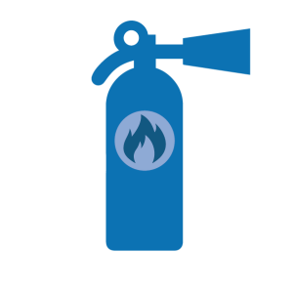
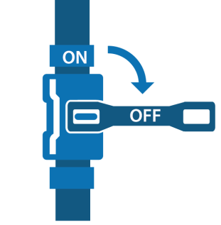

Disaster skills training
Learn how to use a fire extinguisher
Check on and control utilities
  Shut off water at the main house valve
  Shut off natural gas ONLY if necessary
Construct an emergency toilet
Learn basic first aid skills
Light Search & Rescue
Stop the Bleed
Sign up for classes at www.seattle.gov/emergency
Notes:
Some of the other priority actions after a disaster include controlling fires, controlling utilities, helping others around you by doing some light search and rescue, and basic first aid.
Attend one of our upcoming skills classes to learn these skills or brush up!

Slide 43

Questions?
Thank you for attending- you’ll be happy you prepared ahead of time when the next disaster strikes!

Slide 44
Important Links
www.Seattle.gov/emergency-management
OEM@Seattle.gov
Carl.Leon@Seattle.gov
www.SeattleEmergencyHubs.org
Unofficial:
Youtube.com/@SeattlePrepares
www.n7kuw.com/Handouts/
(hint: download handoutlist.pdf first)

